Slide 1


What kinds of things are important in a friend?
I think a good friend.../For me, a good friend...
The most important thing for me is that a good friend...
It’s the most important for me that a good friend...
______ a. has cool clothes.
______ b. is talented in music.
adj. 有才能的;有才干的
______ c. likes to do the same things as me/I do.
______ d. is good at sports.
v. 关心；在意
care about关心；在意
______ e. truly cares about me.
adv. 真正,确实
______ f. makes me laugh.
v. 笑（有笑声)
n. 笑声
______ g. is a good listener.

Slide 2


1. A good friend is talented in music. 在音乐方面有天赋。
talented adj. 有才能的；有才干的
比较级 more talented
be talented in… 在……有才能
e.g. 我的好朋友很有音乐才能。(翻译)
My best friend is talented in music.
【助记】
talent (n. 天资；天才)+ -ed (形容词后缀)→ talented (adj 有才能的)

Slide 3
2. A good friend truly cares about me. 确实关心我。
truly adv. 真正；确实
常位于be、情态动词或助动词之后，实义动词之前。
e.g. She is truly talented in sports.
她确实有运动天赋。
Jack truly studies hard.
杰克学习确实努力。

Slide 4
care v. 在意；担忧；关心
care about 关心；在意
e.g. She felt that nobody cared.
她觉得没有人在意。
Your mother truly cares about you.
你妈妈确实关心你。

Slide 5
3. A good friend makes me laugh. ……让我笑
make sb. do sth. 让某人做某事
使役动词make / have / let后要跟省略to的动词不定式作宾语补足语。
e.g. The teacher made me answer this difficult question.
老师让我回答这个难题。

Slide 6

make sb./ sth. +形容词 让某人/某物……
该结构中的形容词作宾语补足语。
e.g. You should make yourself happy.
你应该让你自己开心。

Slide 7

laugh与smile
laugh | 一般表示“出声地(大)笑”，不但有面部表情，而且还有声音 | laugh at 嘲笑……
smile | 一般表示“无声地微笑”，指的是面部表情 | smile at 向……微笑

Slide 8


根据汉语意思，完成英语句子，每空一词。
1. Mrs. White真的很关心她班里的学生。
Mrs. White really _______ _______ the students in her class.
2. 那个女孩在数学方面有天赋。
The girl _______ _______ _______ math.
3. 是什么原因让你说出那种话来？
What _________ you _________ that?
4. 她是一个很好的倾听者。
She is a very ___________ ___________.
cares about
is talented in
made say
good listener

Slide 9

Talk about what you think a good friend should be like.
A good friend...
______ a. has cool clothes.
______ b. is talented in music.
______ c. likes to do the same things as me/I do.
______ d. is good at sports.
I think...
For me, ...
It’s not important for me that ...
It’s important for me that ...
The most important thing in a friend is to...
______ e. truly cares about me.
______ f. makes me laugh.
______ g. is a good listener.

Slide 10
Talk about what you think a good friend should be like.
I think a good friend makes me laugh.
For me, a good friend likes to do the same things as me.
It’s not important for me that a good friend has cool clothes.
It’s important for me that a good friend is talented in music.
The most important thing in a friend is to truly care about me.

Slide 11

Unit 3

Slide 12
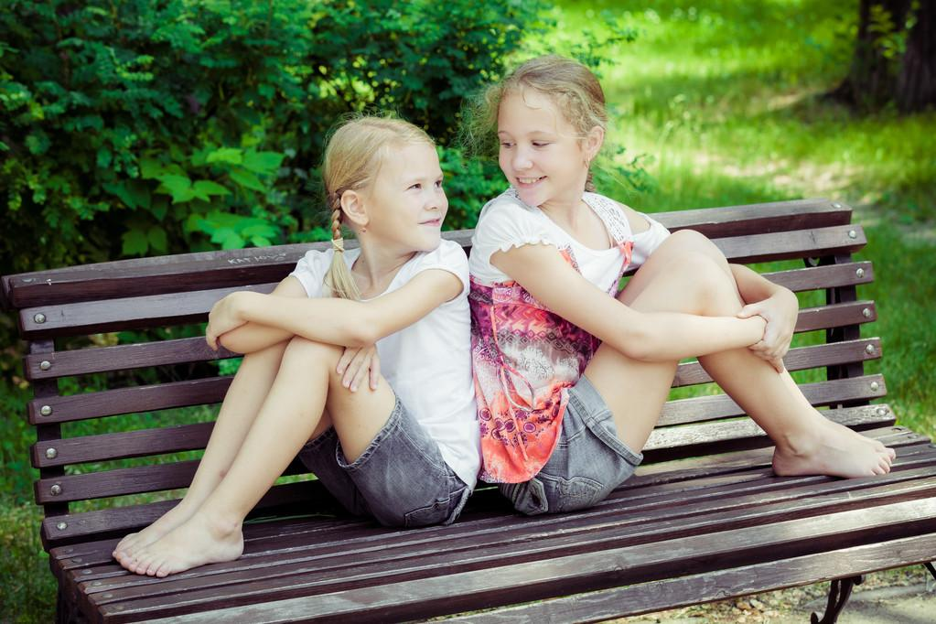
Unit 3
I’m more outgoing than my sister.

Slide 13



Slide 14
What kinds of things are important for you in a friend?
I think a good friend.../For me, a good friend...
The most important thing for me is that a good friend...
It’s the most important for me that a good friend...
...has cool clothes.
...is good-looking.
外貌
...is talented in music.
...is good at sports.
特长/兴趣
...likes to do the same things as me/I do.
...truly cares about me.
talented adj. 有才能的;有才干的
truly adv. 真正,确实
...makes me laugh.
care v. 关心；在意
care about关心；在意
...is a good listener.
...is popular.
laugh
v. 笑（有笑声) n. 笑声

Slide 15


Interview about best friend
Listen. What do Molly and Mary like about their best friends? Fill in the first column of the chart.
 | Like about their best friends
Molly (Peter) | 1.Peter likes to do the same things. 2. 3.
Mary (Lisa) | 1.
He’s popular.
He’s good at sports.
Lisa is a good listener.

Slide 16
Interview about best friend
Listen. What do Molly and Mary like about their best friends? Fill in the first column of the chart.
 | Like about their best friends
Molly (Peter) | 1.Peter likes to do the same things. 2. 3.
Mary (Lisa) | 1.
He’s popular.
He’s good at sports.
Lisa is a good listener.

Slide 17

Listen again. How are Molly and Mary the same as and different from their best friends? Complete the rest of the chart in 1c.

Slide 18
 | The same as their best friends | Different from their best friends 用比较级。
Molly (Peter) | 1. They | 1. Molly studies harder. 2. 3.
are both outgoing
Peter plays baseball better.
Peter speaks more loudly./
Molly is quieter.
 | The same as their best friends | Different from their best friends
Mary (Lisa) | 1.They are both tall. 2. | 1. Lisa is quieter. 2. 3.
They both have
long, curly hair.
Lisa is also smarter.
Mary talks more./
Mary is more outgoing.

Slide 19

Review
在……方面有才能/天赋
真正关心/在意
一个善于倾听的人
擅长(做)某事
使某人做某事
和……相同/一致
对我来说，一个好朋友喜欢做和我一样的事。
be talented in
truly care about
a good listener
be good at (doing) sth.
make sb. do sth.
the same as
For me, a good friend likes to do the same things as me/I do.

Slide 20
Interview about best friend
Interviewer: Who’s your best friend, Molly?
Molly: Peter.
Interviewer: Why do you like him?
Molly: Because he likes to do the same things as I do. He’s popular, too, and he’s good at sports.
Interviewer: So, is he different from you in any way?
Molly: Well, yes. I like to study. I study harder than Peter. He plays baseball better than me.
Interviewer: OK, I see…

Slide 21
Molly: Oh, and he speaks more loudly than me. I’m a little quieter. But I’d say we’re both pretty outgoing.
Interviewer: How about you, Mary? Who’s your best friend?
Mary: My best friend is Lisa.
Interviewer: What do you like about her?
Mary: Well, she’s a good listener, and that’s important to me.
Interviewer: Is she a lot like you?
Mary: Some people say we look similar. We’re both tall, and we both have long, curly hair. But Lisa is quieter than me. I’m always talking. She’s also smarter. I’m more outgoing.

Slide 22

Exercise
Write the comparative forms of the following adjectives. Then use them to write five sentences about you and your friends.
funnier
popular ____________ funny ________
hard-working ___________________
quiet ________ serious _____________
friendly _________ smart _________
outgoing _____________ shy _______
more popular
more hard-working
adj. 严肃的；稳重的
quieter
more serious
friendlier
smarter
more outgoing
shyer
e.g. My friend David is more hard-working than me, but I am funnier than him.

Slide 23


Slide 24
They are both tall.
同义句：Both of them are tall.
They both are tall.

Slide 25
What kinds of things are important for you in a friend?
I think a good friend.../For me, a good friend...
The most important thing for me is that a good friend...
It’s the most important for me that a good friend...
...has cool clothes.
...is good-looking.
外貌
...is talented in music.
...is good at sports.
特长/兴趣
...likes to do the same things as me/I do.
...truly cares about me.
talented adj. 有才能的;有才干的
truly adv. 真正,确实
...makes me laugh.
care v. 关心；在意
care about关心；在意
...is a good listener.
...is popular.
laugh
v. 笑（有笑声) n. 笑声

Slide 26
Review
在……方面有才能/天赋
真正关心/在意
一个善于倾听的人
擅长(做)某事
使某人做某事
和……相同/一致
对我来说，一个好朋友喜欢做和我一样的事。
be talented in
truly care about
a good listener
be good at (doing) sth.
make sb. do sth.
the same as
For me, a good friend likes to do the same things as me/I do.

Slide 27


Write about you and your best friend …
What do you like about him/her?
The same things between you.
The differences between you.

Slide 28


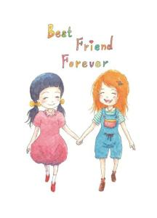
As the saying goes
A life without a friend is a life without a sun. 人生没有朋友，犹如生活没有了太阳。
A friend in need is a friend indeed.
患难见真情。
A faithful friend is hard to find.
知音难觅。
Be slow in choosing a friend; slower in changing.
选择朋友要慎重，改换朋友更要慎重。

Slide 29
What kinds of things are important in a friend? Rank the things below [1-7] (1 is the most important.)
______ a. has cool clothes.
adj. 有才能的;有才干的
A
good
friend
…
______ b. is talented in music.
______ c. likes to do the same things as me.
______ d. is good at sports.
______ e. truly cares about me.
v. 在意，担忧；关心
care about关心；在意
adv. 真正,确实
______ f. makes me laugh.
v. 笑；发笑
n. 笑声
______ g. is a good listener.

Slide 30


To talk about what kinds of things you think are important in a friend
To listen for specific information about Molly’s and Mary’s best friend
To talk about Molly and Mary and their best friends

Slide 31


与两年前的自己进行比较。
1. Are you more outgoing now?
Yes. I’m more outgoing than I was two years ago.
2. Are you friendlier?
3. Do you study harder?

Slide 32
Talk about your parents.
1. Who is funnier, your mom or your dad?
2. Who works harder?
3. Who sings better?
4. Who is more outgoing?
5. Who drives better?

Slide 33


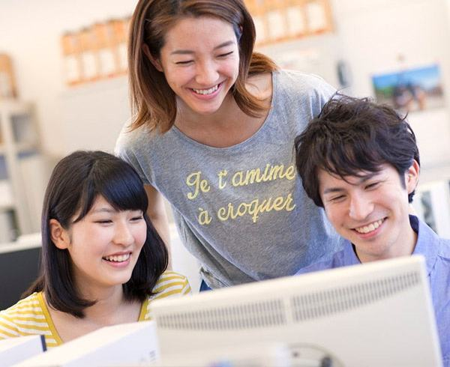
What do you think a good friend should be like?
A good friend should be outgoing.
A good friend can help me.
A good friend must be fun.
A good friend can always understand me.
A good friend …

Slide 34
likes to do the same things as me
humorous
friendly
honest
friends
kind
a good listener
helpful
care about me
make me laugh

Slide 35


What do you think a good friend should be like?
①A good friend should….
②
③
④

Slide 36
A good friend… is good at sports. is good at school work. is popular at school. likes to do the same things as me. has cool clothes and hair style. makes me laugh. is more outgoing than me. has good grades. likes telling jokes. keeps secrets. …
My view

Slide 37
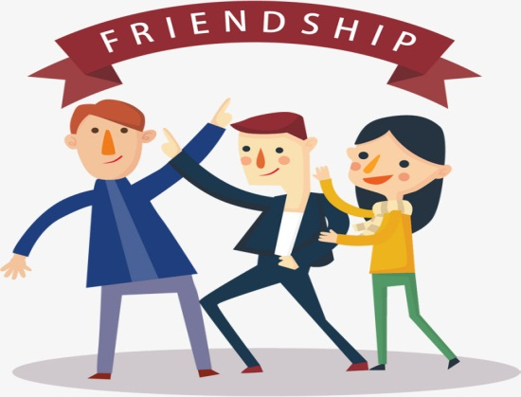


Is he a good friend?
When you fight with others, he helps you to fight.
When you are tired, he does homework for you.
When you meet a thief, he runs away quickly.
When you are thirsty, he gives you a cup of tea.
When you don’t know the answers in the exam, he gives
you the answers to copy.

Slide 38

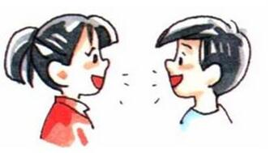

Important patterns:
I think …
For me, …
In my eyes, …
I guess…
It’s important for me that …
For me, it is not very important …
I don’t / can’t agree that a good friend …
For me, a good friend …

Slide 39

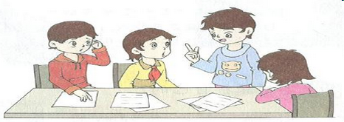
Who is your best friend?
Why do you like him/her?
Is she/he different from you in any way?
What do you like about him/her?

Slide 40

Listen. What do Molly and Mary like about their best friends? Fill in the first column of the chart.
观察题目及表格，利用问题了解对话的人物关系。
Listen again. How are Molly and Mary the same as and different from their best friends? Complete the rest of the chart in 1c.
 | Like about their best friends | The same as their best friends | Different from their best friends
Molly | Peter likes to do the same things. |  | Molly studies harder.
Mary |  | They are both tall. | Lisa is quieter.

Slide 41
 | Like about their best friends | The same as their best friends | Different from their best friends
Molly | Peter likes to do the same things. |  | Molly studies harder.
Mary |  | They are both tall. | Lisa is quieter.
1. How many people are having the conversation? Who are they?
2. Who’s Peter?
3. What’s the name of Mary’s best friend?
4. Of the four names here, how many girls and how many boys are there? Why do you think so?

Slide 42

What are the differences or the similarities between you and your friend?
name
Tom
 | not as …as
We both …
…than…
as …as …
Tom is my best friend. We both …
I…as…as…
He ….than me.
He doesn’t…me.

Slide 43



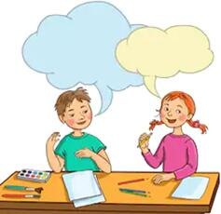
Talk about Molly and Mary and their best friends.
Well, Mary and her best friend are both tall.
Molly studies harder than her best friend.

Slide 44
true, truly, truth
true | 是形容词，在句中分别作表语和定语，意为“真的；真实的”。
truly | 是副词，意为“真实地；真心地”， 词义相当于sincerely。
truth | 意为“真相；事实”，是不可数名词，常与the连用。但当它表示“真理”时，是可数名词。

Slide 45
【语境应用】根据句意，用true, truly或truth填空。
1) I am ______ grateful for all your help.
2) I don’t believe the ______ of that story.
3) Is it ______ that Martin and Sue are getting married?
truly
truth
true

Slide 46
care n. 小心；注意；关怀
take care (=be careful) 当心，小心
take care of (=look after) 照顾，照看
e.g. Take care not to fall into the river.
当心不要掉进河里。
You should take care of yourself.
你应该照顾自己。

Slide 47
【语境应用】完成句子。
1) 嘲笑陷入麻烦的人不好。
It isn’t good to _______ _______ a person in trouble.
2) John突然大笑起来，然后说：“Mary总是这么有趣。”
John _______ _______ _______ _______ _______ and said,
“Mary is always so funny.”
3) Tom听了我的笑话没有发笑。
Tom didn't _______ _______ my jokes.
laugh at
broke into a loud laugh
laugh at

Slide 48
laugh vi. 笑；发笑
laugh at ①嘲笑；②因……发笑
e.g. He laughed, and told me not to do it again.
他笑了，告诉我不要再那样做了。
We shouldn’t laugh at others when they are in trouble.
当别人陷入困境时，我们不应该嘲笑他们。

